Slide 1
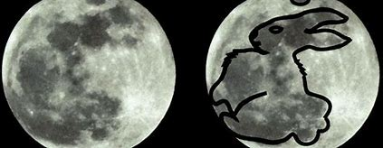
Observing climate change with a 3D-printed Moon Rabbit

Slide 2
Agenda
Global Warming – the facts
The link between man-made CO₂ emissions and global warming.
What can we in education do? 3D printed CO₂ detector
A call for education to participate.
Working together to create a more interactive community, sharing images, data and real-time weather.

Slide 3
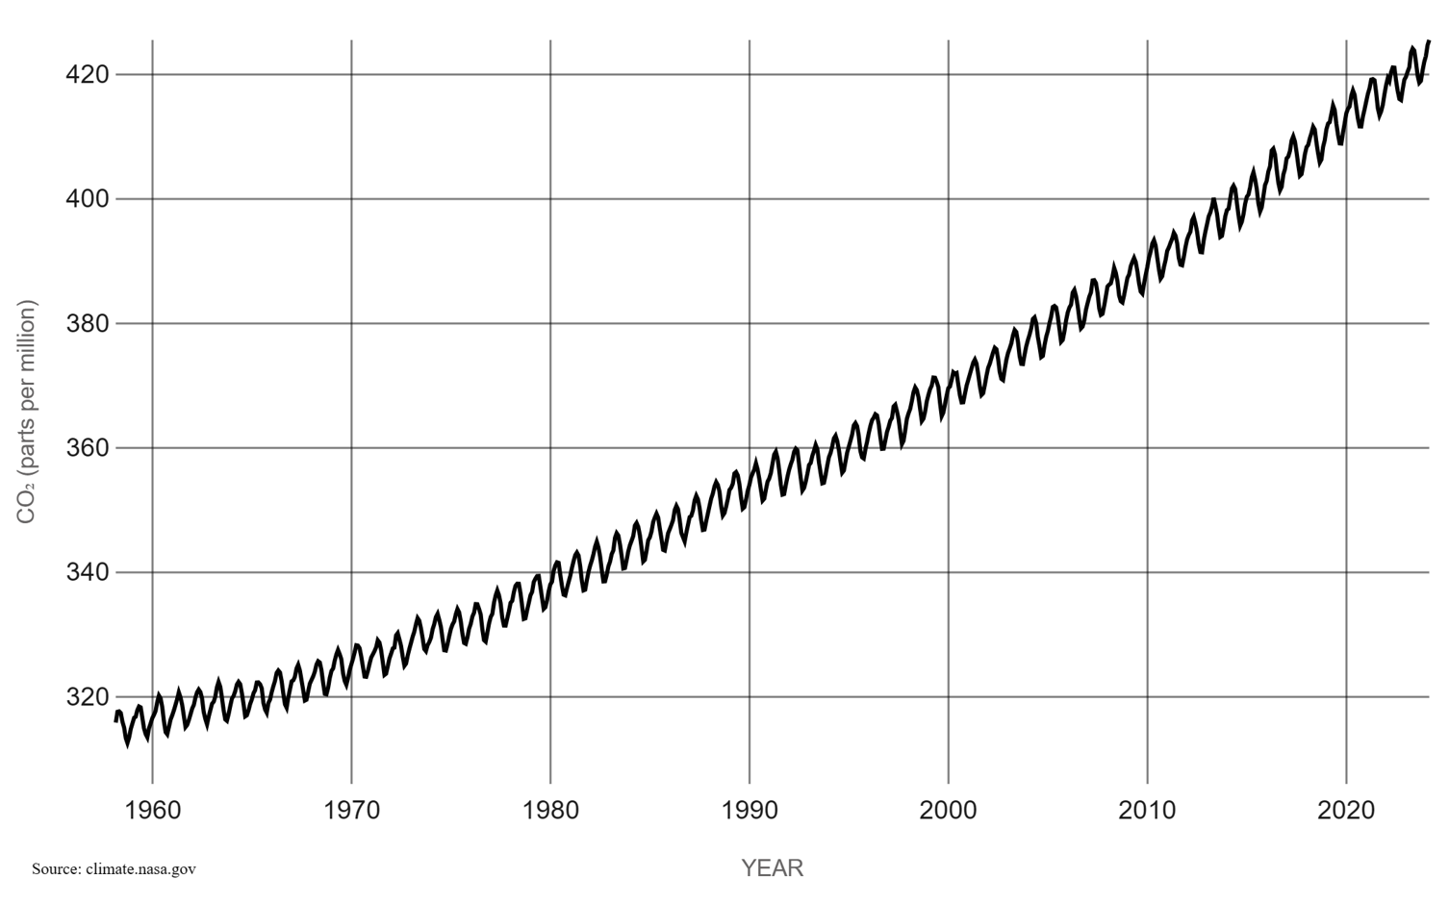
CO₂ Concentration for last 67 years
From Mauna Loa Observatory in Hawaii from 1958 to 2025.
Concentration in parts per million (ppm).
Seasonal variations about 8 ppm.
Annual growth about 2 ppm.
LATEST MEASUREMENT (NASA):
May 2025​: 429.6 ppm. The highest ever.
Kyoto
Protocol
Paris
Accord

Slide 4
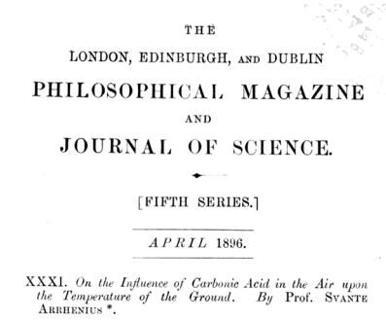
1896
Swedish Professor Svante Arrhenius published his epoch-defining paper:
“On the influence of Carbonic Acid in the Air upon the Temperature of the Ground”.

Slide 5
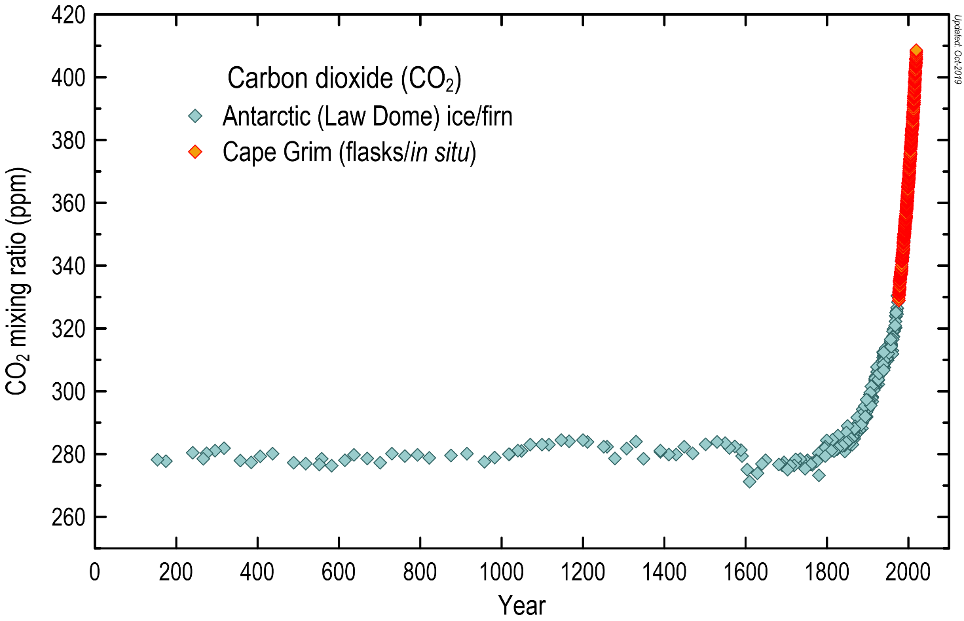
CO₂ in the last 2,000 years.
Past CO₂ levels can be determined by measuring the air trapped in ice cores from Antarctica.
So far, the Antarctic Vostok and EPICA Dome C ice cores have provided a composite record of atmospheric carbon dioxide levels over the past 800,000 years.

Slide 6
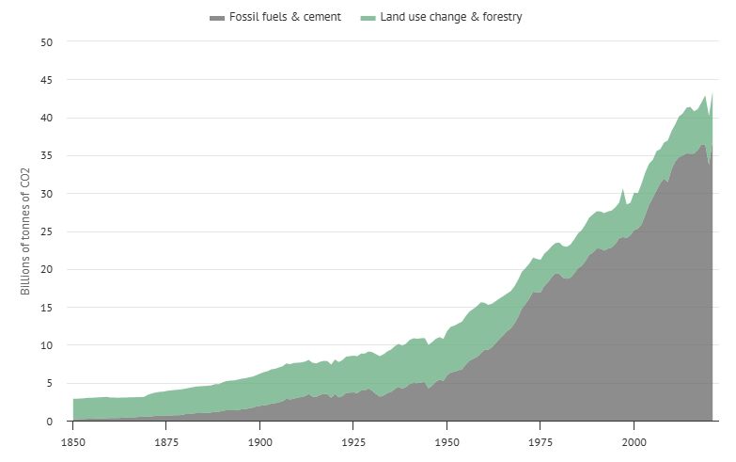
CO₂ emissions in the last 175 years.
Land use change & forestry
Fossil Fuels & cement

Slide 7
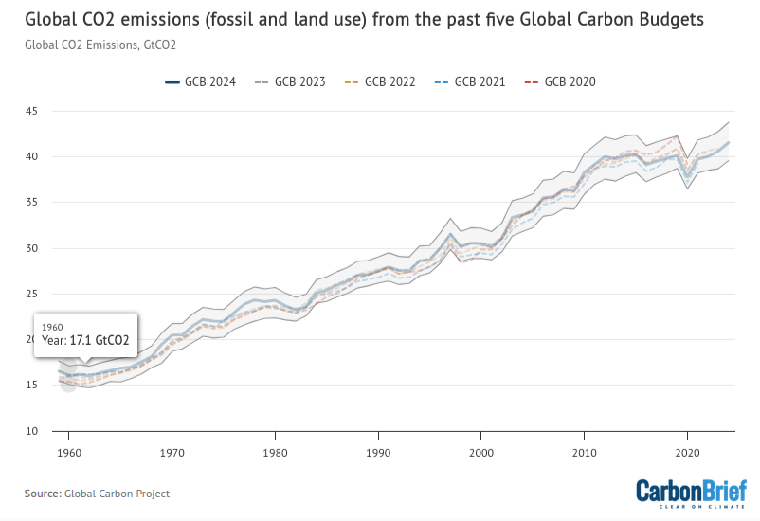
Global fossil CO₂ emissions recently (41.6 Gt in 2024)

Slide 8
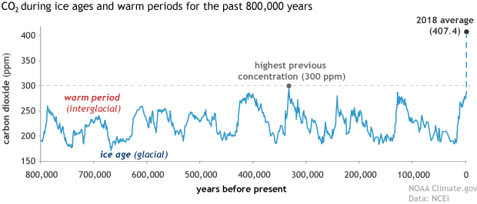
Last 800,000 years of CO₂
Past CO₂ levels can be determined by measuring air trapped in ice cores from Antarctica.

Slide 9
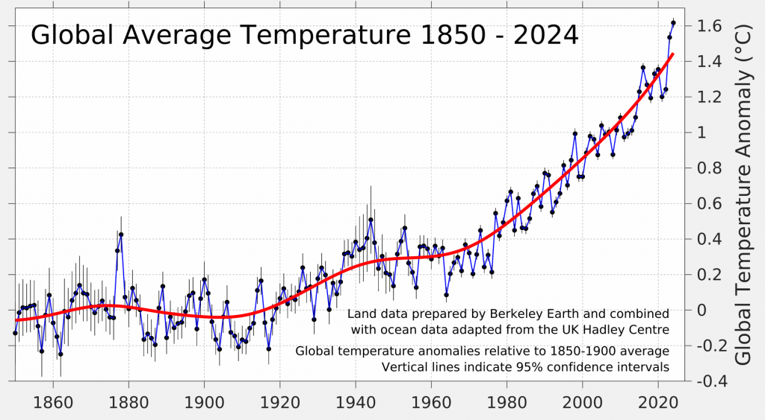
Recent global temperatures

Slide 10
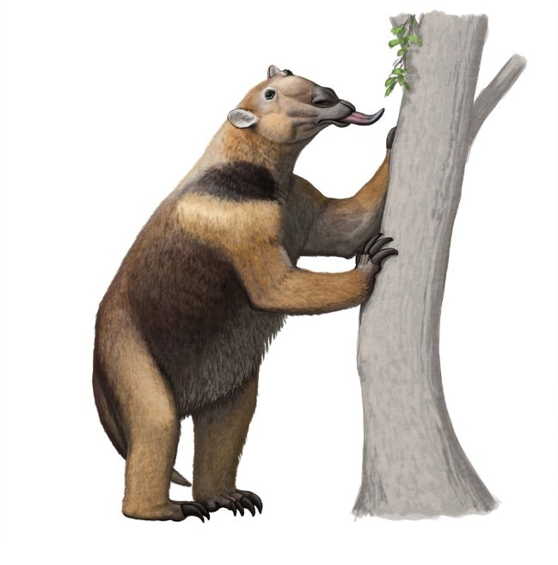
The last time CO2 was at current levels was 20 million years ago, during the Cenozoic Era
Date | Event
20 Ma | First giraffes, hyenas, and giant anteaters, increase in bird diversity.

Slide 11
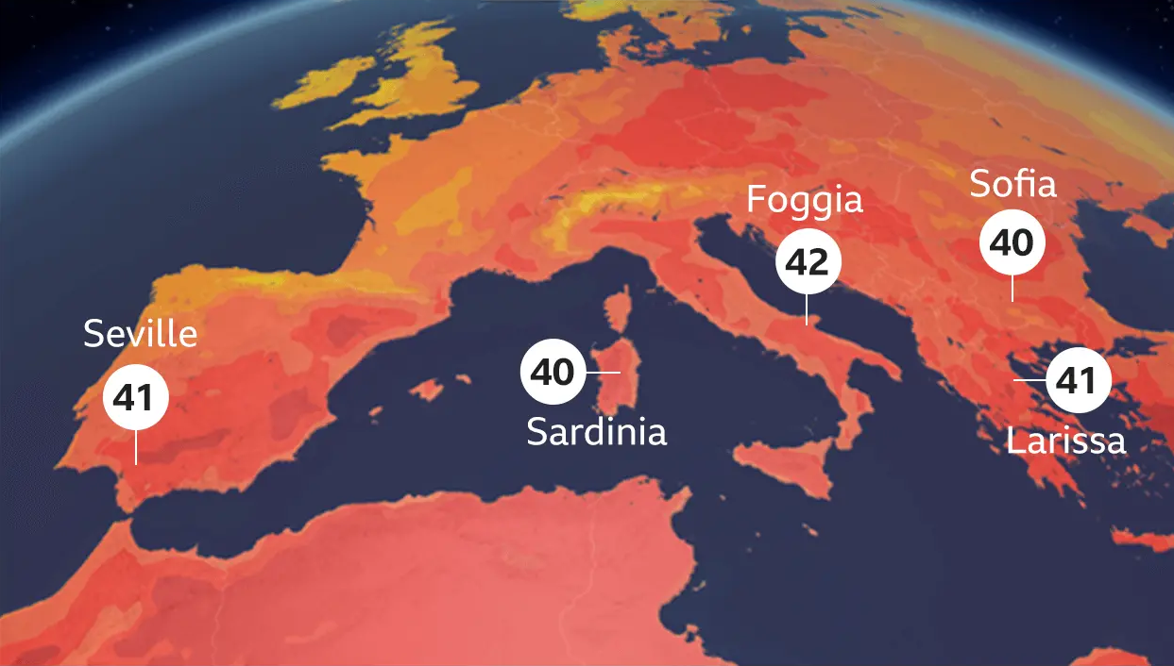
European Heatwave 2023 (BBC)

Slide 12
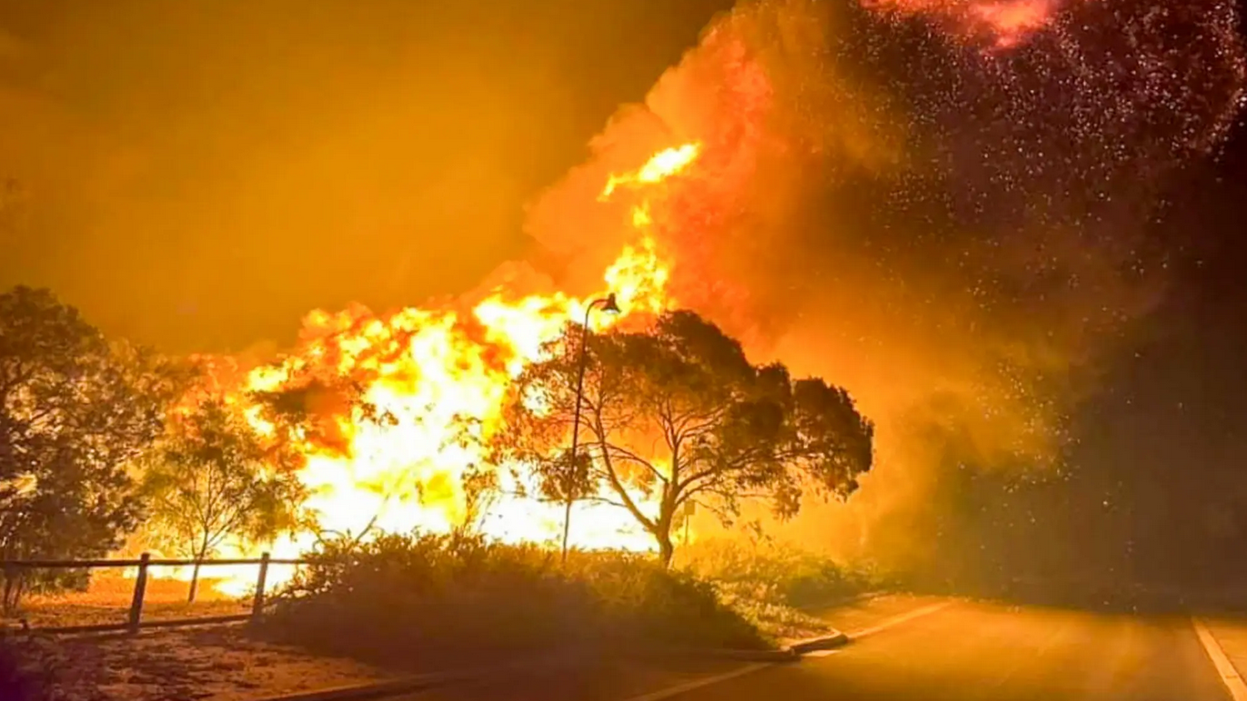
Australian bushfires 2023 (NYT)

Slide 13
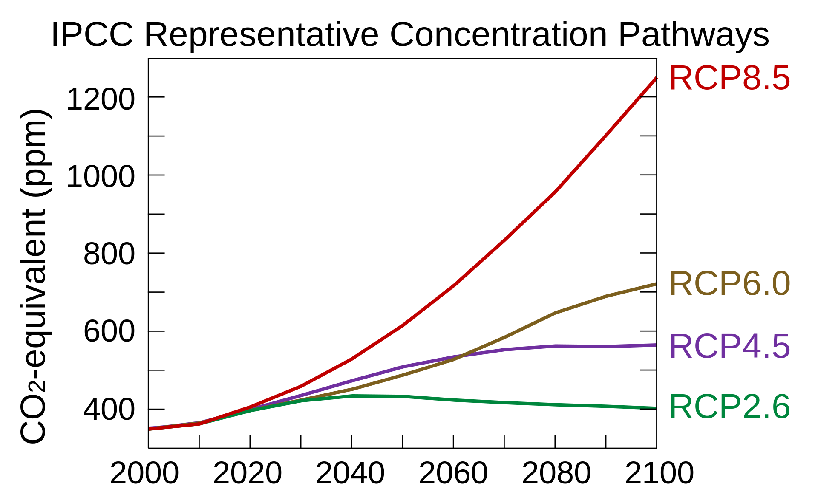
Representative Concentration Pathway
RCPs are a range of scenarios for the year 2100.
"When planning for managing the impacts of weather events, most of our clients are using RCP8.5 as a benchmark, although some use RCP6.0. Our recommendation is to continue to work with weather events as RCP8.5 is what we will need to live through, and then work back from there".
* Intergovernmental Panel on Climate Change.

Slide 14
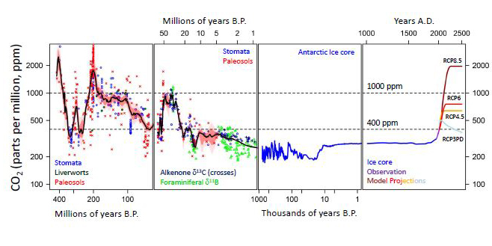
CO₂ Atmospheric Concentration

Slide 15
The half-life of CO₂ is 120 years.
Carbon dioxide has a half-life of about 120 years.
Trees and plants absorb about 35%.
Oceans dissolving the remaining 65% (but warming oceans dissolve less).
If we stopped all CO₂ output today, half of our CO₂ debt would still be there in 2148.
Outstanding Carbon Debt: ~ 0.8 Trillion Tonnes of CO₂

Slide 16
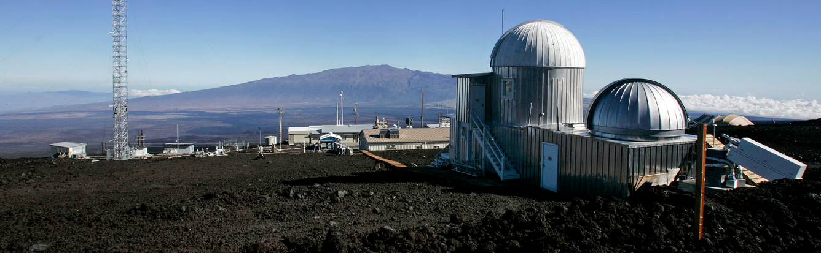
The Mauna Loa Observatory has set the way for 67 years.
Global CO₂ readings have been taken by the Mauna Loa Observatory in Hawaii since the measurements began in 1958.
The Mauna Loa Observatory land-lease is up for renewal in August and is being defunded by the US administration along with other aspects of NASA (50% cut) and the National Oceanic and Atmospheric Administration (NOAA) - 27% cut.

Slide 17
Moon Rabbit Intro
Moon Rabbit is a self-built, dynamic real-time CO₂ sensor designed to educate and empower communities worldwide.
It captures CO₂ readings continuously, publishing data both locally—to your mobile device or PC—and globally via an interactive map that can be interactively explored in detail.
At its core, Moon Rabbit is a programme of self-build, experimentation and self-directed learning, tailored especially for the education community.
By enabling students, educators and families to build and deploy their own Moon Rabbit devices, the project fosters environmental awareness and hands-on STEM education.
Together, we are building a community-driven, global CO₂ map to inform, inspire, and help shape a more sustainable future.

Slide 18

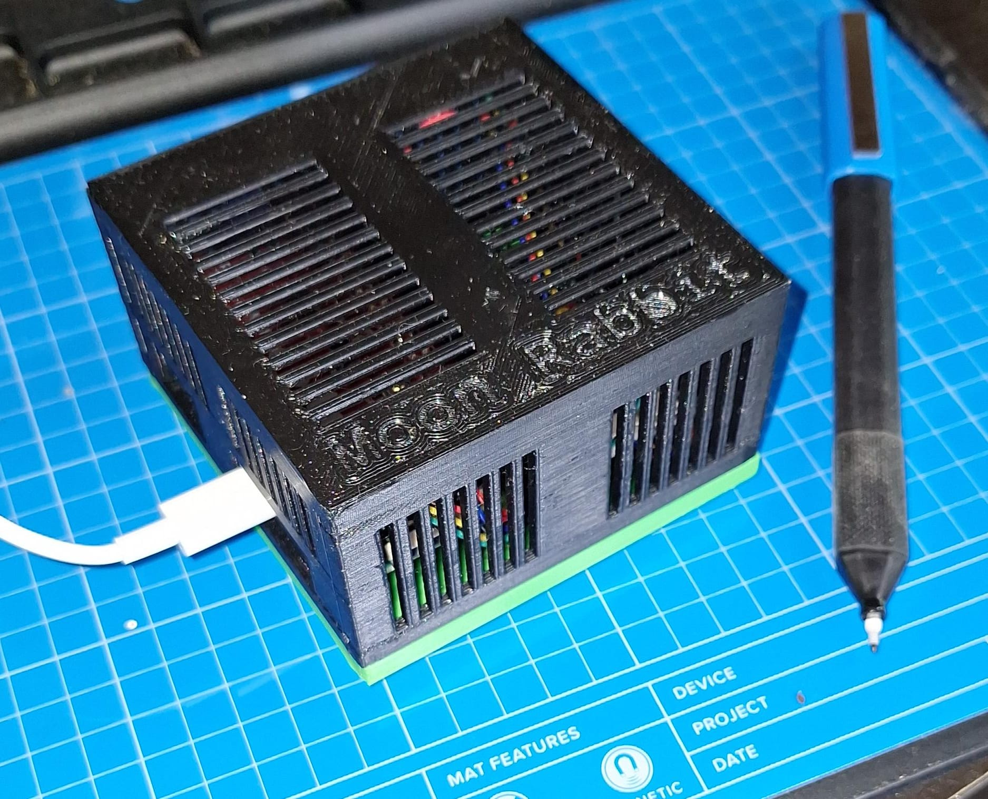
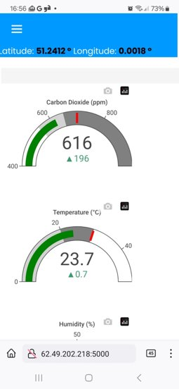
Climate change & Moon Rabbit
Build your own CO₂ sensor to educate and empower
Self-directed learning for the education & STEM community
Enables students, educators & families to build and deploy their own devices
Together, we are building a global CO₂ community to inform, inspire, and help shape a more sustainable future.
Real-time CO₂ data on your mobile or PC
Explore globally via an interactive map
Promotes environmental awareness and STEM education
Kyoto
Protocol
Paris
Accord
Atmospheric
CO₂

Slide 19
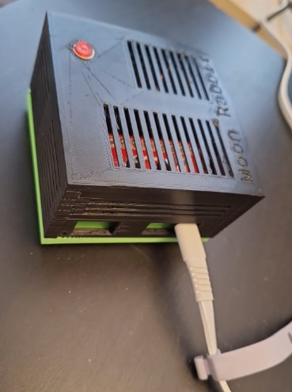
Moon Rabbit
The Moon Rabbit legend is a popular part of local folklore throughout Asia. It may be found in diverse cultures in China, Japan, Korea, Sri Lanka, Cambodia, Thailand, Vietnam, Myanmar and even Mexico.
Stories are told about the brave rabbit that was rewarded and honoured for his courage and can now be seen on the moon.
That's 4 billion potential climate activists.

Slide 20
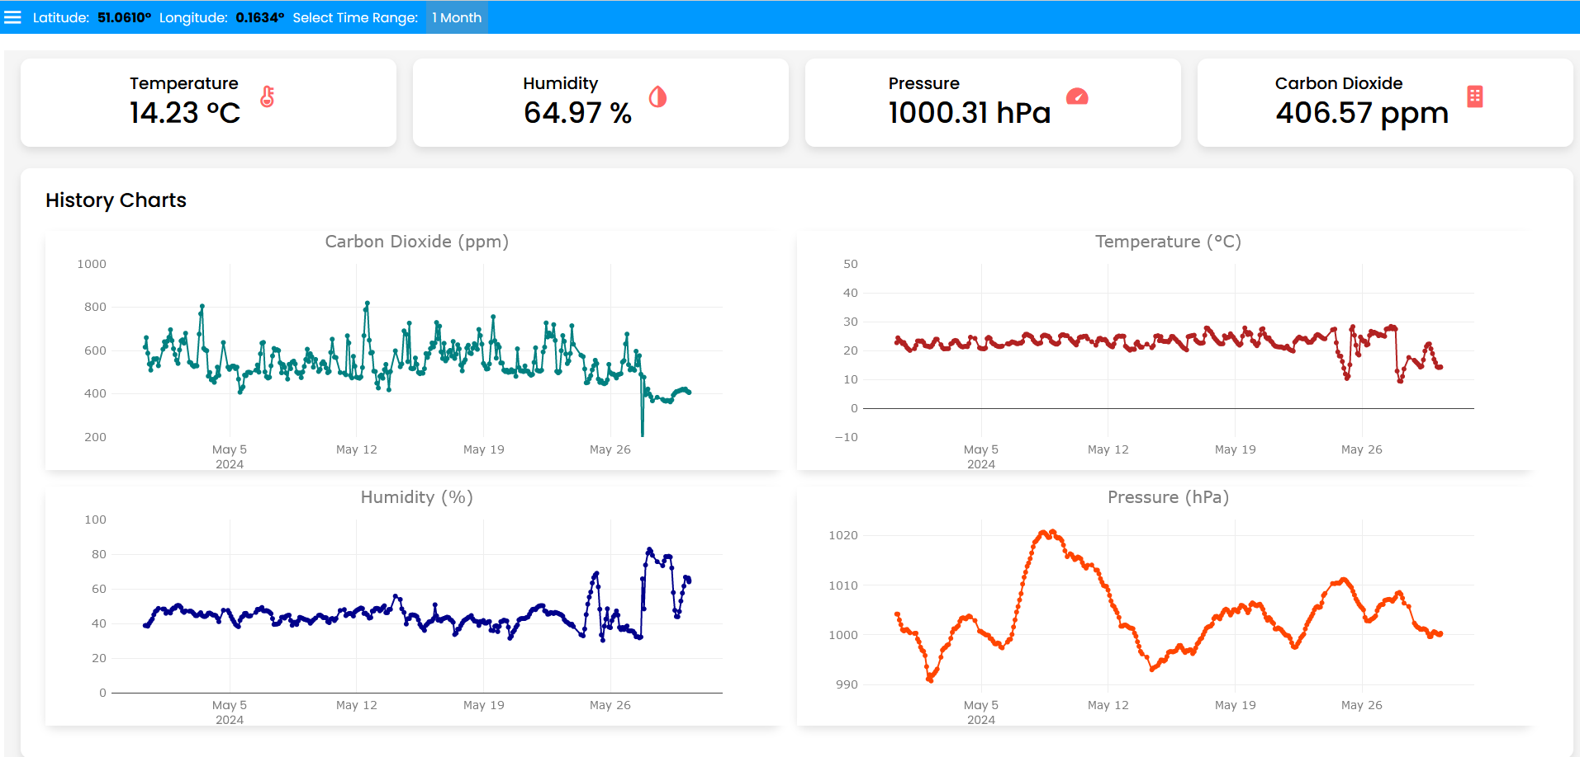
A local weather dashboard
From your own device;

Slide 21
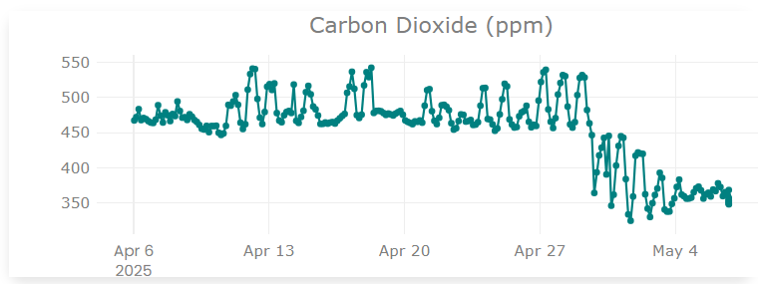
Moon Rabbit Projects
Building Moon Rabbit: Construct and deploy a DIY, Moon Rabbit CO₂ monitors to empower students to collect and analyse environmental data
CO₂ and Learning: Measure classroom CO₂ levels and correlate them with student concentration and test performance over a term.
Traffic and Air Quality: Compare CO₂ levels in classrooms at varying distances from major roads to assess the impact of traffic emissions.
CO₂ and the Daily Cycle: Track diurnal CO₂ changes in school grounds to explore links between photosynthesis, cloud cover and air quality.
Many more...
Skills developed
These projects help students build real-world scientific and technical skills, including 3D printing, coding and electronics (Raspberry Pi), sensor calibration, environmental data collection, data analysis, graphing and critical thinking. They also encourage teamwork, project planning, experimental design, and communication — all while connecting science learning to urgent global challenges like climate change.

Slide 22
Learning Outcomes – no initial skills needed Participants gain hands-on experience and a broad range of interdisciplinary skills
Design and engineering through 3D printing
Electronics and construction, learning soldering and assembly of the device
Technical Skills – installing and configuring hardware and software
Programming in Python and web design for the CO₂ capture/web readouts
Accuracy and calibration of CO₂ measurement (vacuum pumps etc)
Environmental awareness and the effect of CO₂ on temperature and climate
Numeracy and data analysis - applying statistics to interpret collected data meaningfully
Applied Psychology, creating standardised tests (eg does student performance or behaviour in the classroom vary with CO₂ levels?)

Slide 23
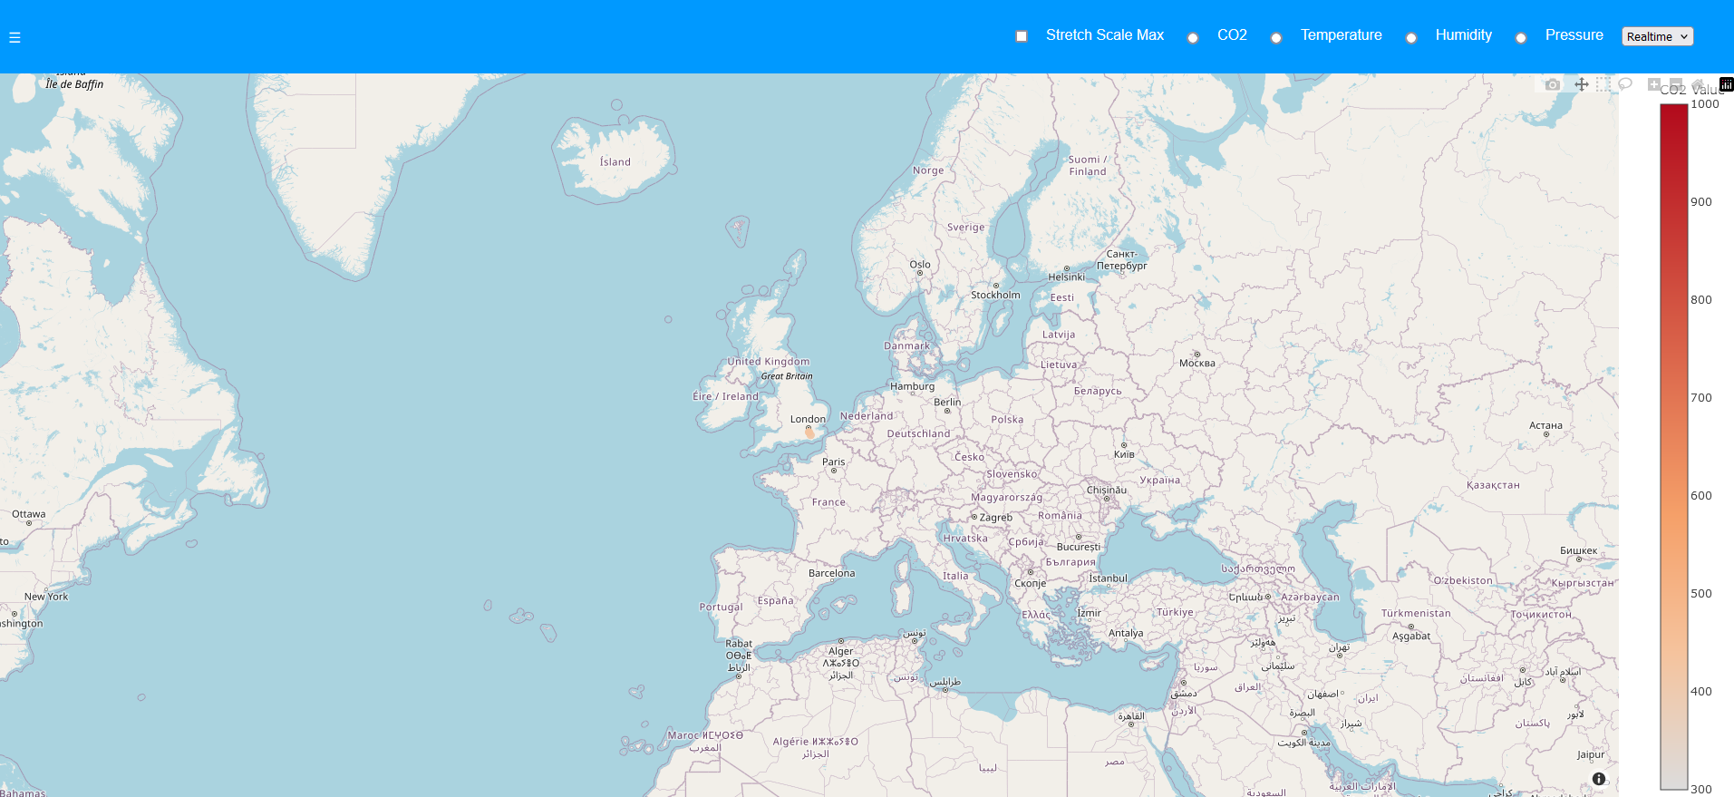
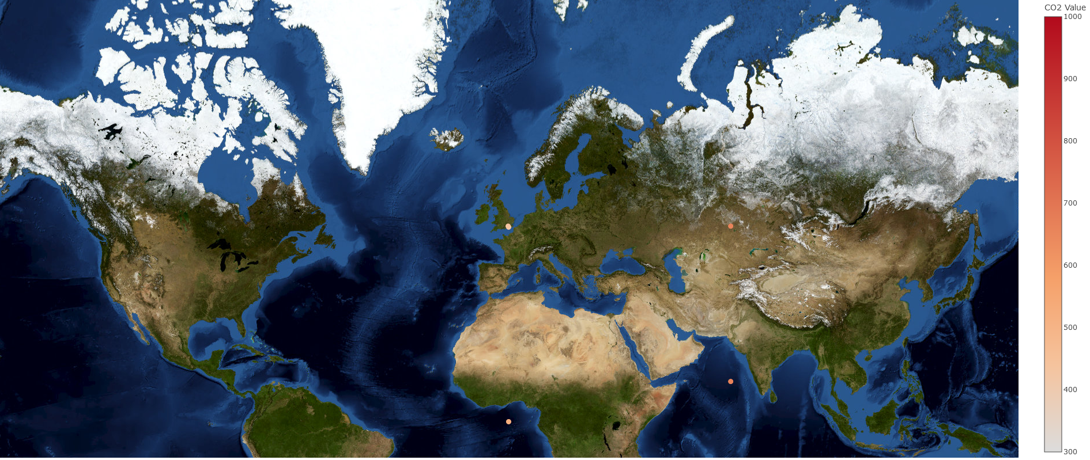
A global CO₂ map showing the terrian (centred on Crawley, natch)
<- Dinosaurs
<- Giant
Anteaters

Slide 24
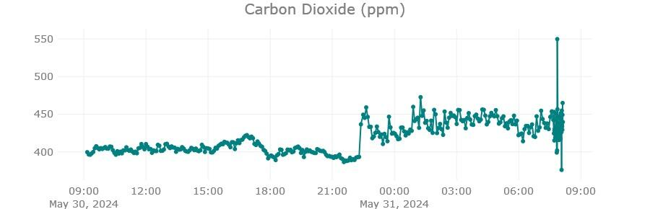
CO₂ use case 1) - Living near a road
I wish I'd had a webcam recording it.

Slide 25
Other Use-cases
2) Urban versus rural living
3) Gas central heating
4) Living near an industrial area
5) Daily variation and photo-synthesis
6) Student performance or behaviour vs CO₂
7) Collaborating with other schools

Slide 26
The future done right.
Either way, at the end of this, if we survive, it's a massive economic boom for the winners;
Huge excitement: this is like a space-race for the whole planet.
We're going to just need a lot of new technologies and it's a massive opportunity for everyone, because it's an advance that affects the whole world.
A cleaner Earth could be better Earth.

Slide 27
A call to participate
The Moon Rabbit costs about £125 in parts from the UK to build a bit less if you order from China. Plus you need to calibrate it.
You can make one yourself (you'll need a 3D printer and soldering iron).
You'll need a waterproof outside space with Wi-Fi or Network to participate.

Slide 28
Options
After school STEM Club
Option 1: Pilot Project – cost of materials only
Option 2: Train and Support Teachers – cost of materials, plus support
Option 3: Deliver after school club – cost of materials, delivery plus support.

Slide 29
Questions?

